Slide 1
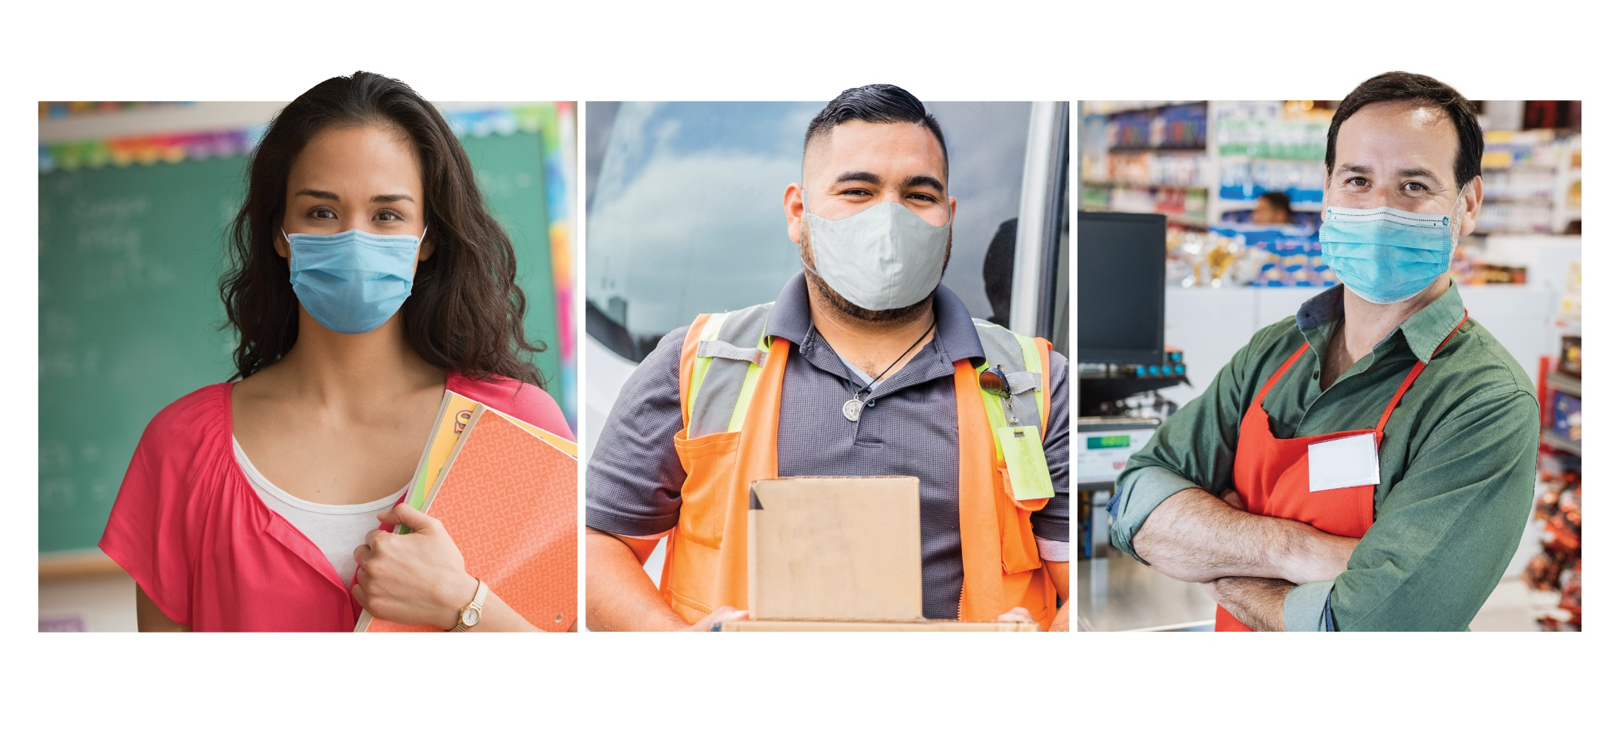

COVID-19
Vaccine
Information
for Employers of Essential Workers
JANUARY 2021
FOR MORE INFORMATION: cdc.gov/COVID19
Notes:
NOTE: The slide set is in the public domain. These basic slides about the COVID-19 vaccine are for virtual town hall or other informational meetings with your communities. You can use all or part of the set, or also include your own organization’s information.
These sides were created in January 2021. They will be updated as needed.

Slide 2
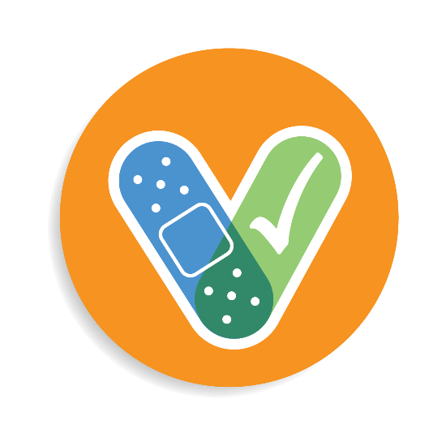
COVID-19 and Vaccine Basics

Slide 3


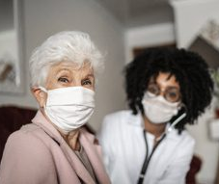
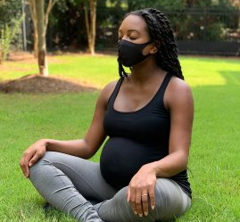
What is known about COVID-19?
COVID-19 and Vaccine Basics
Infection with SARS-CoV-2, the virus that causes COVID-19, can result in a range of illness, from mild symptoms to severe illness and death.
We don’t know how SARS-CoV-2 will affect each person.
Some people, such as adults 65 and older or people with certain medical conditions, are more likely than others to become severely ill.
Notes:
It is known that infection with SARS-CoV-2, the virus that causes COVID-19, can result in a range of illnesses, from mild symptoms to severe illness and death. About 30% of persons infected with SARS-CoV-2 do not have symptoms. No one can predict how severe any person’s illness might be, but certain factors may increase your risk. Some people are more likely than others to become severely ill when infected, such as older adults or people with certain medical conditions, like diabetes, obesity, cancer, or heart disease.

Slide 4
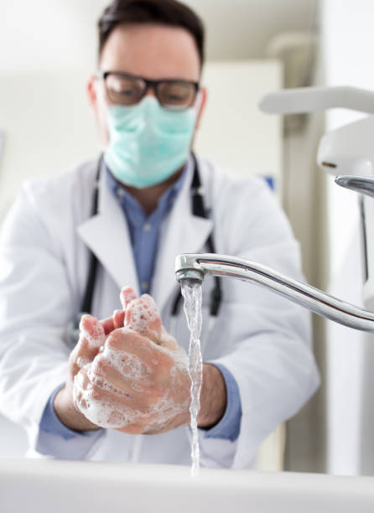
COVID-19 and Vaccine Basics
How to prevent COVID-19
Wear a mask that covers your mouth and nose.
Avoid close contact with others. Stay at least 6 feet (about 2 arm lengths) from other people.
Avoid crowds and poorly ventilated spaces.
Wash hands often with soap and water.
Use an alcohol-based hand sanitizer with at least 60% alcohol if soap and water are
not available.
Avoid touching your eyes, nose, and mouth with unwashed hands.
Clean and disinfect frequently touched
surfaces daily.
Get a COVID-19 vaccine.
Notes:
Actions that everyone should take to help prevent COVID-19.
Wear a mask that covers your nose and mouth. Avoid close contact with others as much as possible. Avoid touching your face--your eyes, nose, and mouth--with unwashed hands. Clean frequently touched surfaces. Wash your hands often with soap and water for at least 20 seconds. And use an alcohol-based hand sanitizer with at least 60% alcohol, if soap and water are not readily available. These are all tools in our toolbox, and the more tools we use to prevent the spread of the virus that causes COVID-19, the safer we all will be.

Slide 5
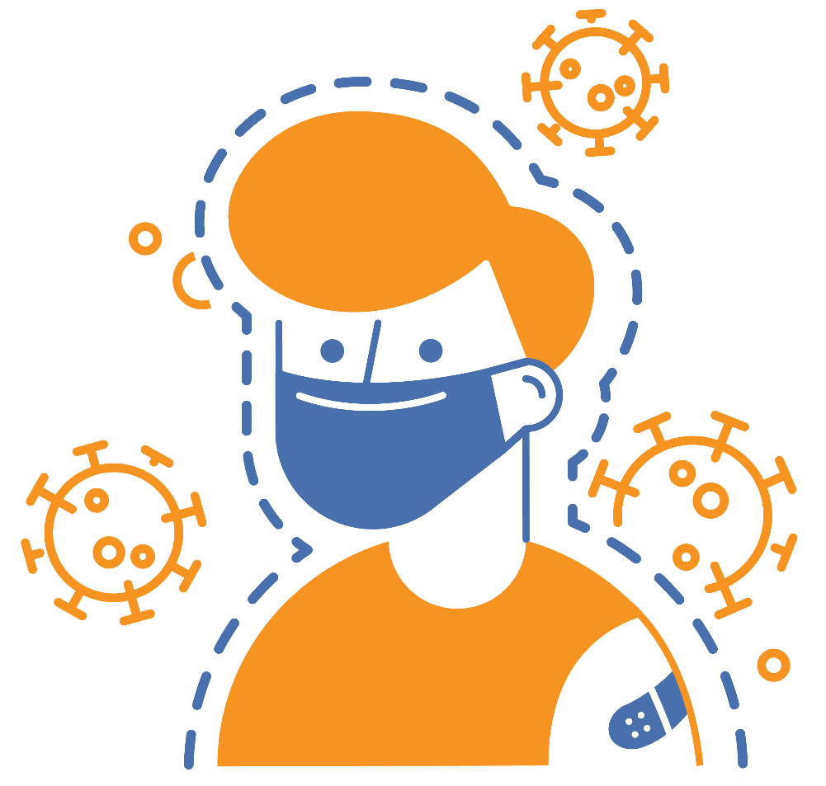
COVID-19 and Vaccine Basics
COVID-19 vaccination is a safer way to build protection
Getting the virus that causes COVID-19 may offer some natural protection, known as an antibody or immune. But experts don’t know how long this protection lasts.
The risk of severe illness and death from COVID-19 far outweighs any benefits of natural immunity.
COVID-19 vaccination will help protect you by building immunity without the risk of severe illness.
Notes:
COVID-19 vaccination is a safer way to help build protection. Getting the virus that causes COVID-19 may offer some natural protection, known as immunity. But experts don’t know how long this protection lasts, and the risk of severe illness and death from COVID-19 far outweighs any benefits of natural immunity. COVID-19 vaccination will help protect you.

Slide 6




COVID-19 and Vaccine Basics
Key facts about COVID-19 vaccination
Getting vaccinated can help prevent getting sick with COVID-19
People who have already gotten sick with COVID-19 may still benefit from getting vaccinated
COVID-19 vaccines cannot give you COVID-19
COVID-19 vaccines will not cause you to test positive on COVID-19 viral tests*
https://www.cdc.gov/coronavirus/2019-ncov/vaccines/about-vaccines/vaccine-myths.html
*https://www.cdc.gov/coronavirus/2019-ncov/hcp/testing-overview.html
Notes:
It is easy to be confused by all the information that is circulating, some of which may be conflicting. CDC has facts to counteract common myths on this page, such as:
COVID-19 vaccines will not give you COVID-19
People who have gotten sick with COVID-19 may still benefit from getting vaccinated
Getting vaccinated can help prevent getting sick with COVID-19
COVID-19 vaccines will not cause you to test positive on COVID-19 viral tests*
Please visit: https://www.cdc.gov/coronavirus/2019-ncov/vaccines/about-vaccines/vaccine-myths.html to read more about these vaccine myths and the facts about COVID-19 vaccine from CDC.
NOTE: While COVID-19 vaccination will not cause a positive result on viral tests, there is a possibility that it could cause a positive result on a serologic (antibody) test.

Slide 7




COVID-19 and Vaccine Basics
Safety of COVID-19 vaccines is a top priority
COVID-19 vaccines are being held to the same safety standards as all vaccines.
Before Authorization
After Authorization
ACIP
FDA carefully reviews all safety data from clinical trials.
ACIP reviews all safety data before recommending use.
FDA and CDC closely monitor vaccine safety and side effects. There are systems in place that allow CDC and FDA to watch for safety issues.
V-safe: https://www.cdc.gov/coronavirus/2019-ncov/vaccines/safety/vsafe.html
Notes:
COVID-19 vaccines are being held to the same safety standards as other routine vaccines. Several expert and independent groups evaluate the safety of vaccines being given to people in the United States.
Before ANY vaccines receive authorization or approval, the Federal Drug Administration (FDA) carefully reviews all the safety data from clinical trials. And the Advisory Committee on Immunization Practices, or ACIP, which is an independent body of experts, reviews all safety data before recommending use. FDA and ACIP have qualified scientific and clinical experts with minimal conflicts of interest reviewing all of the data.
After ANY vaccines are authorized and in use, both FDA and CDC continue to monitor their safety.
Existing systems can rapidly detect possible vaccine safety problems. These systems are being scaled up for COVID-19 vaccine introduction to fully meet the needs of the nation. Additional systems and data sources are also being developed to further enhance safety monitoring capabilities.
There are systems in place that allow CDC and FDA to watch for safety issues:
CDC: V-safe — A new smartphone-based, after-vaccination health checker for people who receive COVID-19 vaccines. V-safe uses text messaging and web surveys from CDC to check in with vaccine recipients following COVID-19 vaccination. V-safe also provides second vaccine dose reminders if needed, and telephone follow up to anyone who reports medically significant (important) adverse events.
CDC and FDA: Vaccine Adverse Event Reporting System (VAERS) — The national system that collects reports from healthcare professionals, vaccine manufacturers, and the public of adverse events that happen after vaccination; reports of adverse events that are unexpected, appear to happen more often than expected, or have unusual patterns are followed up with specific studies.

Slide 8

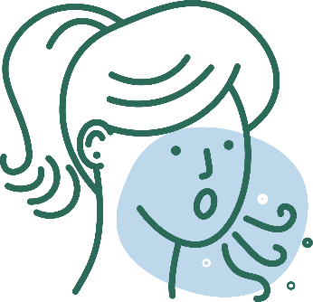
COVID-19 and Vaccine Basics
COVID-19 vaccination will help protect you from COVID-19
Getting a COVID-19 vaccine...
  Will help create an immune response in your body against the virus
  May help keep you from getting severely ill, even if you do get COVID-19
Notes:
COVID-19 vaccination will help keep you from getting COVID-19. Getting a COVID-19 vaccine will help create an immune response in your body against the virus without your having to experience illness. Based on what is known about vaccines for other diseases, experts believe that getting a COVID-19 vaccine may help keep you from getting seriously ill even if you do get COVID-19.

Slide 9

COVID-19 and Vaccine Basics
What to expect before, during, and after COVID-19 vaccination
Before
  Learn about COVID-19 vaccines.
  See if COVID-19 vaccination is recommended for you.
During
  Read the fact sheet that tells you about the specific COVID-19 vaccine you receive.
  Receive a vaccination record card.
After
  Expect some
  side effects.
  Enroll in v-safe. V-safe will remind you if you need a second shot.
  Continue using all
  the measures to protect yourself and others.
V-safe: https://www.cdc.gov/coronavirus/2019-ncov/vaccines/safety/vsafe.html
Notes:
Before vaccination, you should learn more about the different types of COVID-19 vaccines and how they work. We’ve provided some of this information in this presentation.
During your vaccination appointment, you should receive a paper or electronic version of a fact sheet specific to the COVID-19 vaccine you are being offered that contains information to help you understand the risks and benefits of receiving that specific vaccine. After you are vaccinated, you should be given a vaccination record card that tells you what COVID-19 vaccine you received, the date you received it, and where you received it.
Your provider may also give you information about how to enroll in v-safe. V-safe is a free, smartphone-based tool that uses text messaging and web surveys to provide personalized health check-ins after you receive a COVID-19 vaccination. This program will help CDC monitor safety of COVID-19 vaccines. Find more information at https://www.cdc.gov/coronavirus/2019-ncov/vaccines/safety/vsafe.html.
Its important to continue using all the tools available to help stop this pandemic. Cover your mouth and nose with a mask when you are around others, stay at least 6 feet away from others, avoid crowds, and wash your hands often.

Slide 10
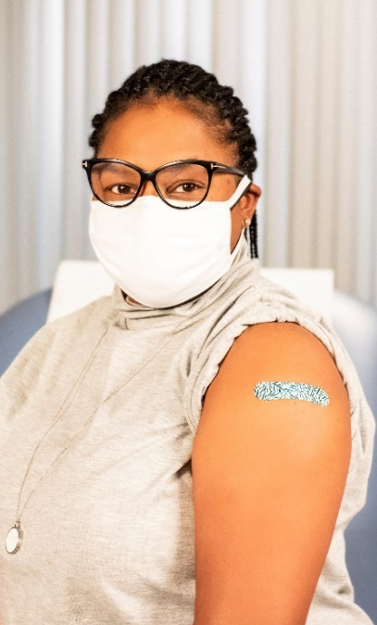
COVID-19 and Vaccine Basics
Vaccination is one measure to help stop the pandemic
While COVID-19 mRNA vaccines appear to be highly effective, additional preventive tools remain important to limit the spread of COVID-19.
The combination of getting vaccinated and following CDC recommendations to protect yourself and others offers the best protection from COVID-19.
  Cover your nose and mouth with a mask.
  Stay at least 6 feet from people who don’t live with you.
  Avoid crowds and poorly ventilated indoor spaces.
  Wash your hands.
Notes:
COVID-19 vaccination will be an important tool to help stop the pandemic, but it continues to be one tool in the toolbox. While COVID-19 mRNA vaccines appear to be highly effective, additional preventive tools remain important to limit the spread of COVID-19. The combination of getting vaccinated and following CDC’s recommendations to protect yourself and others will offer the best protection from COVID-19. Wash your hands. Avoid close contact. Cover your nose and mouth with a mask. Clean and disinfect frequently touched surfaces. Stopping a pandemic requires using all the tools we have available.
It will take time to vaccinate all people living in the United States. While the vaccines are being delivered, it's important that everyone continue to take all steps (wear a mask, avoid close contact with others, and wash your hands) to prevent spread of COVID-19.

Slide 11
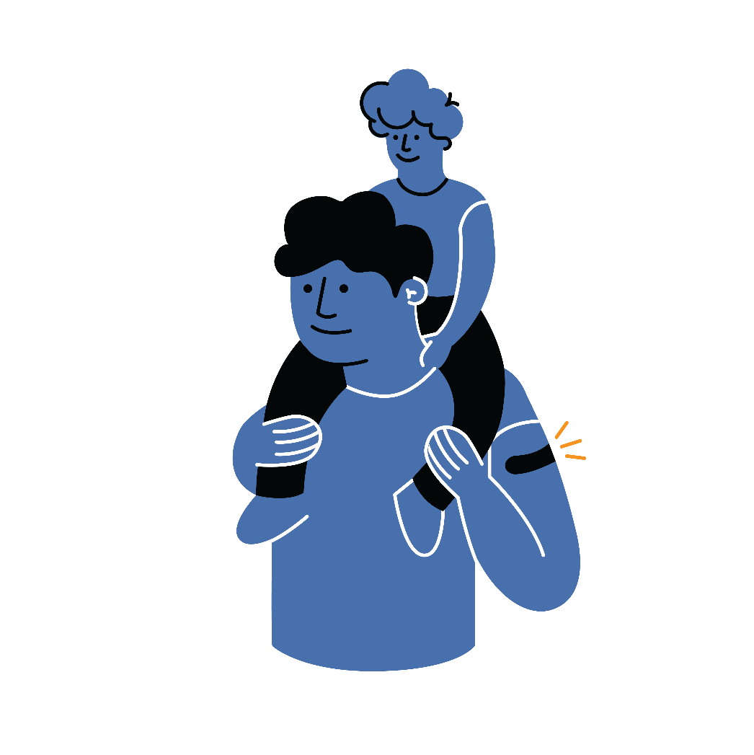
COVID-19 and Vaccine Basics
Protect yourself, your family, friends, coworkers, and your community.
Get vaccinated.
Choose to get vaccinated when it is offered.
Participate in v-safe and help CDC monitor for any health effects after vaccination.
Share your experience with coworkers, friends, and family.
Know the basics about the COVID-19 vaccine. Help answer questions from your family and friends.
Show you received the vaccine by wearing a sticker
or button prominently.
Notes:
COVID-19 vaccination can protect you, your family, your friends, and your community. Choose to get vaccinated. Participate in v-safe and help CDC monitor for any health effects after vaccination. Share your experience with your coworkers, friends, and family. And visibly show that you received a vaccine by wearing a sticker or button. You have a role in increasing confidence in COVID-19 vaccination and sharing your experience may influence those you care about.

Slide 12
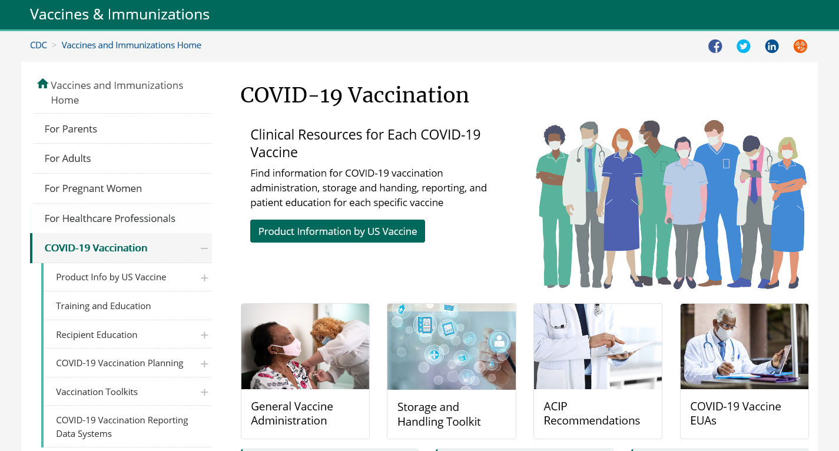
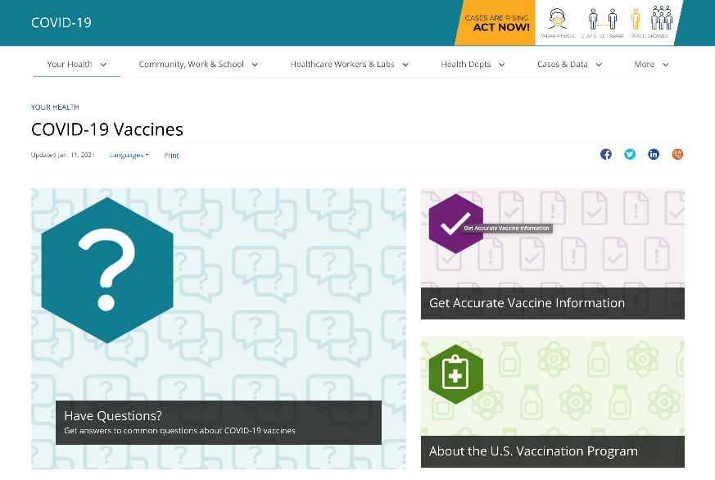
COVID-19 and Vaccine Basics
CDC COVID-19 Vaccine Websites
https://www.cdc.gov/vaccines/covid-19/index.html
https://www.cdc.gov/coronavirus/2019-ncov/vaccines/index.html

Slide 13
Getting Vaccinated

Slide 14
Getting Vaccinated
Where and when to get your vaccine
Notes:
Please add information here on where your affiliates will be offered the COVID-19 vaccine, how they make appointments, and where they go.
The federal government is providing the vaccine free of charge to all people living in the United States.
If you have questions about your health and vaccination, call your doctor, nurse, or clinic.

Slide 15

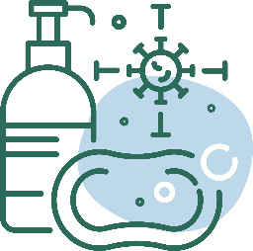
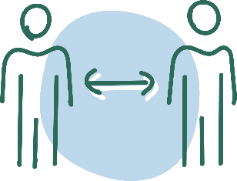

Getting Vaccinated
After Vaccination
Continue COVID-19 prevention measures:
Enroll in V-safe
If you have questions about your health and vaccination, call your doctor, nurse,
or clinic.
  Cover your nose and mouth with a mask.
  Stay at least 6 feet from people who don’t live with you.
Avoid crowds and poorly ventilated spaces.
Wash your
hands.
Clean and
disinfect frequently touched surfaces.
Notes:
If you experience a fever after vaccination, you should stay home from work if you can. Most side effects after vaccination do not last very long. The vaccine does not give you COVID-19. However, you could have been exposed to the virus before you were vaccinated, so if you continue to feel sick, you should consider getting a COVID-19 test. CDC and FDA encourage the public to report possible side effects to the Vaccine Adverse Event Reporting System (VAERS). CDC is also implementing a new smartphone-based tool called v-safe to check in on people’s health after they receive a COVID-19 vaccine. If you enroll in v-safe, you can tell CDC if you have any side effects after getting a COVID-19 vaccine. If you report serious side effects, someone from CDC will call to follow up.

Slide 16
For more information about COVID-19 and vaccines:
www.cdc.gov/COVID19

